Slide 1


Sports Scholarships
at RCHK
Mr Nick Sherriff-Smith
Athletic Director
Kelly Megan -
Cross Country, Track & Field
Mr Lee Burns
Head of Physical Education
Nicholas Cox -
Ultimate Frisbee, Cross Country, Track
Sports Scholarship Students

Slide 2
Presentation contents
The ‘Black Kites’ sports programme at RCHK
Application & Selection Process
Expectations
Summary
Q&A

Slide 3
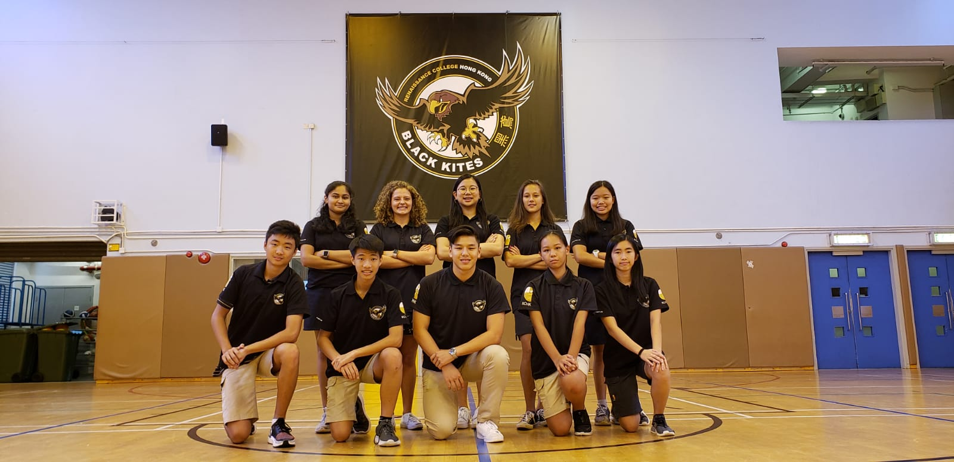
Sports Scholarships
overview
Awarded to students in recognition of outstanding achievement in Sports
Normally have approximately 10 sports scholars at any one time
Applicants must demonstrate high achievement and effort in physical education and athletic programmes
Applicants must have a commitment to leading and developing the sports culture at the college including representation and promotion of sport.
Only students in Y9+ are eligible to apply.
Applicants must maintain a very high standard in physical education classes and co-curricular commitments whilst meeting overall academic standards

Slide 4
Goals of sports scholarships
To recognise the contribution of our top athletes to RCHK sports teams
To promote sports participation and spectatorship at RCHK
To raise RCHK’s profile in the International School Sports Community
To recognise and foster the development of these athletes as leaders and role models in the RCHK community

Slide 5
Mission
The Black Kites Programme’s mission is to support the RCHK mission and bedrock principles where relevant.
To Seek, To Serve, To Strive
We seek challenging experiences through extensive sporting opportunities and competition.
We serve our community and our peers by representing them with integrity, cultivating an inclusive environment and passing on knowledge.
We strive to improve performance and health whilst fostering positive relationships, leadership and collaborative skills.

Slide 6
Vision
To improve our students’ physical and mental health and life readiness.
To provide a high-quality sports coaching programme that encourages extensive participation across multiple sports and competes at the highest levels in Hong Kong and the Asia region.
To improve facilities, services and resources associated with the programme to support athletes of all levels.
To involve the community in all aspects of the programme and provide opportunities for service.

Slide 7
Values
Our four values are the moral characteristics we are looking to develop in the Black Kites programme.
All stakeholders should be guided by these values and endeavour to demonstrate them in their practices.
Commitment
Participation
Positive Relationships
Growth

Slide 8
Philosophy
Our values can be expressed in our programme's philosophy:
Control Your ‘FEAR’
On any day, no matter the situation, (in the classroom, in training or on match day) you are in control of four things that will directly affect your performance and therefore success
Black Kites athletes are encouraged to take control of their:
FOCUS , EFFORT , ATTITUDE & RESPECT

Slide 9
Sports at RCHK
Tier 1 (Core) | Tier 2
Swimming Volleyball Basketball Football | Badminton Netball Ultimate Frisbee Track & Field Cross Country
Tier 3 (Minor) | Tier 4 (Supported)
Touch Rugby Cricket Ball Hockey | Aquathon Fencing Golf Equestrian

Slide 10
Tier Definitions
Tier one (Core) sports
  Tier one consists of our major sports, they are generally sports with the largest number of students participation and are considered major sports in the ISSFHK.
  We send teams to ACAMIS or other overseas competitions in these sports every year. ACAMIS requires entry in the red division for the three team sports. In swimming, the extensive ‘RCHK Swim Club’ programme runs alongside the Black Kites programme and trains all year round. Tier one sports tend to receive more resources, such as scholarships and external coaches.
  Our aim is for the Black Kites to compete at the highest level in these sports in both domestic and international competitions.
Tier two sports
  Tier two consists of major sports that are popular but do not fall into the category of ‘core’ sports. We compete in the ISSFHK at all these sports and provide training sessions at least once a week. Our aim is to build participation and competitiveness in these sports
Tier three (Minor) sports
  Tier three consists of minor sports that are either building numbers or low on numbers. It may also include sports that are not included in ISSFHK competitions These sports may not be offered if sign ups and coaching resources are limited. Our aim is to build participation in these sports.
Tier four (Supported) sports
  Tier 4 includes sports that are not run by our programme but are supported in terms of registration for competitions only. These sports can be part of a variety of federations. Some of these sports do have a member of staff as manager but no formal training takes place unless organised externally. Please see the individual sports pages for further details.
  Our aim is to provide a multitude of opportunities in this category.

Slide 11




Federations and Invitational Leagues
We run a variety of individual and team sports throughout the year.
We enter ISSFHK, HKSSF, ESF, ACAMIS and other invitational competitions.
Sports scholars are expected to compete in all relevant competitions for their chosen sports including attending invitational and overseas tournaments when available.

Slide 12
Assessment Criteria
Sports performance
  This includes past achievements in sport, skills and fitness tests specific to their nominated sport, current level of competition
  To be considered for a scholarship, applicants need to be competing in their chosen sport at a very high level and it must be a sport that RCHK participates in.
Service to Sport and School Community
  Level of involvement in activities occurring at the school and possibly the wider community. Examples include coaching, assisting and/or organising sporting and community service activities
Commitment to the scholarship
  Track record of commitment to school and activities
  Ability to cope with the demands of a scholarship
Fitness
  General and sports specific fitness will be considered

Slide 13
Evidence
Initial application
  Sporting resume evaluation
  Video evidence (where available)
  Referee evaluation
  Achievement* & ATL Grades in PHE
Fitness Testing
Portfolio Presentation and Interview
*Academic Standard - MYP: A minimum score of 40 / DP: A minimum score of 30

Slide 14
Application Process
Step 1
Step 2
Step 3
Step 4
Step 5
Step 6
Application
Submission
Fitness Test
Shortlist
Interview presentation
Final Interview
Complete paperwork, including sporting resume, referee forms and collect video evidence (if available)
Submit by deadline
Friday 7th March
Attend and complete fitness tests
Tuesday 29th April
Shortlisted candidates will be invited to interview by
Wednesday 7th May
Successful candidates and parents will be invited to a final interview with
Ms Shen
Prepare and present a portfolio at the interview
Thursday 15th May

Slide 15

Sporting Resume
Candidates are required to complete an application form including a resumé with references from teachers and/or sports coaches.
If using school staff for references, they do not need to complete this section. We will consult with them directly. Outside referees for internal candidates need to complete only part 2 of the referee evaluation form.
This resume should include details of sporting background, recent achievements and/or awards and notable interests.
Video evidence can be included where available
It should be sports focused but we are interested in a holistic picture of the applicant so inclusion of non sports related information is generally encouraged.

Slide 16
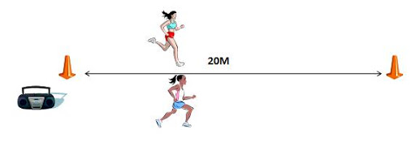
Fitness Testing
Dependent on numbers, all applicants will be invited to a fitness testing session. The following tests will be performed to assess multiple types of fitness.
Specific sports’ fitness requirements that are not easy to assess will be taken into account in the evaluation.
Fitness Test Information

Slide 17

Interview
Shortlisted candidates will be invited to a 30 minute interview with the Athletic Director, Head of PHE and one extra judge from the school community.
Candidates are expected to present a portfolio to support their candidacy.
Interview questions will be asked by the judging panel. These will be related to the presented portfolio or other aspects of being a sports scholar.
Further details of this process can be found here:
Interview Process

Slide 18
Decision Process
Candidates will be selected to receive the scholarship based on aspects of all three sections of the application process.
The decision-making process will look at the following aspects with approximate the percentage weightings:
Criteria | Sports Performance | School and Community Contribution and Leadership | Commitment to the Scholarship | Fitness
Evidence from | Observations, Application form, References and Interview presentation | Application form, References Interview presentation and Q & A | Interview presentation and Q & A | Fitness testing
Approx. Weighting | 40% | 20% | 20% | 20%

Slide 19
Fairness & Transparency
It is our aim to ensure that the application and selection process for the sports scholarship is as transparent and fair as possible.
Detailed information is given about each of the steps. Please follow the links in this presentation. which can be found on the school website.
To avoid any conflict or misinterpretation, The Athletic Director and Head of PHE cannot give explicit advice to individual candidates on their suitability or act as referees, as they will be on the judging panel. They can only give clarification of the requirements and expectations.
The interview panel will include a third adjudicator, external to the PHE department, to give an objective point of view of the candidates interview performance..

Slide 20
Expectations of Sports Scholars
Scholars are expected to not only be elite athletes and leaders in their chosen sport(s). They should contribute to various aspects of the school community through involvement in large scale events and acts of service, including sitting on the Black Kites Athletic Council.
Scholars are expected to: maintain high levels of fitness and readiness to compete; be a leader on and off the field and promote sports of all kinds within the community. They must also maintain good academic standards and exemplary approaches to learning across all subjects.
Examples of further contributions include:
Mentoring/coaching Students
Promoting and contributing to the development of sport at the College through C&S and CAS commitments
Assisting the AD and PHE department in the setup and smooth running of large school events such as the Swim gala, Athletics carnival, ACAMIS hosting, Sports awards ceremony etc.
Commitment to ongoing development of their sport specific skills in and outside of School
Due to the extensive commitment and responsibility of the role, sports scholarships will only be open to year 10-13 students.

Slide 21
Summary of Key Points
We are looking for students of exceptional sporting ability in at least one sport RCHK competes in.
Applicants should also be strong leaders and committed to the community and the promotion of sports
Applicants should meet and maintain minimum standards of academics and be able to cope with extra demands of the role.
The selection process involves completion of application paperwork, fitness tests and an interview presentation.
Deadline for application is 7th March 2025

Slide 22


